Slide 1
Artificial Intelligence

Slide 6
Suppose a genetic algorithm uses chromosomes of the form x = abcdefgh with a fixed length of eight genes. Each gene can be any digit between 0 and 9. Let the fitness of individual x be calculated as: f(x) = (a + b) − (c + d) + (e + f) − (g + h) ,
and let the initial population consist of four individuals with the following
Chromosomes:
a b c d e f g h
x1 = 6 5 4 1 3 5 3 2
x2 = 8 7 1 2 6 6 0 1
x3 = 2 3 9 2 1 2 8 5
x4 = 4 1 8 5 2 0 9 4

Slide 7
Evaluate the fitness of each individual, showing all your workings, and arrange them in order with the fittest first and the least fit last.

Slide 8
2. Perform the following crossover operations:
Cross the fittest two individuals using one–point crossover at the middle point.
Cross the second and third fittest individuals using a two–point crossover (points b and f).
Cross the first and third fittest individuals (ranked 1st and 3rd) using a uniform crossover.

Slide 9
3. Suppose the new population consists of the six offspring individuals received by the crossover operations in the above question. Evaluate the fitness of the new population, showing all your workings. Has the overall fitness improved?

Slide 10
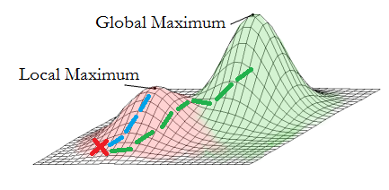
Local Search in Continuous Space
Use discretization
Hill Climbing
Gradient Descent/ ascent
Move in direction of gradient
Image credits: http://sites.ju.edu.jo/sites/Alzalg/Pages/772.aspx

Slide 11
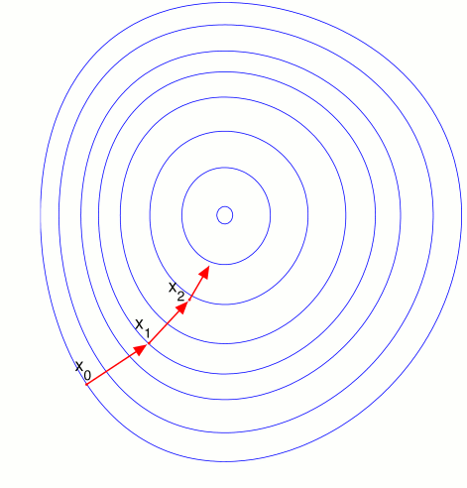
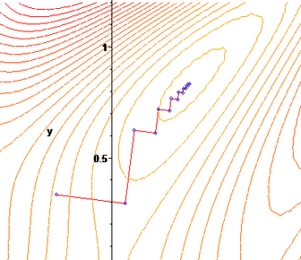

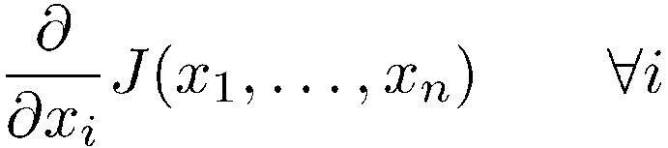
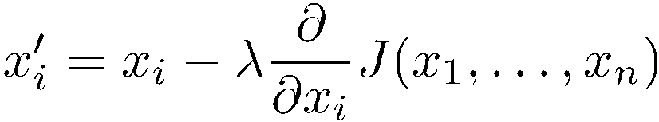
Gradient descent
Hill-climbing in continuous spaces
Gradient = the most direct direction up-hill in the objective (cost) function, so its negative minimizes the cost function.
* Assume we have some cost-function:
and we want minimize over continuous variables x₁,x₂,..,x_{n}
1. Compute the gradient :
2. Take a small step downhill in the direction of the gradient:
3. Check if
4. If true then accept move, if not “reject”.
5. Repeat.
(or, Armijo rule, etc.)
(decrease step size, etc.)

Slide 12
Searching with Non deterministic actions
When the environment is fully observable and deterministic, and the agent knows what the effects of each action are,
percepts provide no new information after the agent determines the initial state.
In partially observable environments,
every percept helps narrow down the set of possible states the agent might be in, making it easier for the agent to achieve its goals.

Slide 13
Searching with Non deterministic actions
In nondeterministic environments,
percepts tell the agent which of the possible outcomes has actually occurred
In both cases, future percepts cannot be determined in advance and the agent's future actions will depend on those future percepts.
A solution to this type of problem is a contingency plan (also know as a strategy)
specifies what to do depending on what percepts are received.

Slide 14
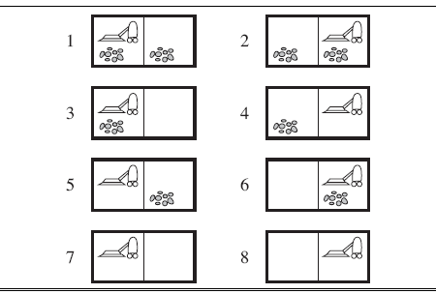
Searching with Non deterministic actions
Example: Erratic Vacuum World, same state space as before. Goal states are 7 and 8.
Suck action is:
When applied to a dirty square, the action cleans the square and sometimes cleans up dirt in an adjacent square, too
When applied to a clean square, the action sometimes deposits dirt on the carpet.

Slide 15
Searching with Non deterministic actions
To formulate this problem, generalize notion of transition model from before. Use Results function that returns a set of possible outcome states.
E.g., Results (1, Suck) = { 5, 7 }
Also generalize notion of a solution to a contingency plan.
E.g., From state 1, [ Suck, if State = 5 then [Right, Suck] else [ ] ]

Slide 16
Searching with Non deterministic actions
Solutions for nondeterministic problems can contain nested if-then-else statements that create a tree rather than a sequence of actions.
Many problems in real, physical world are contingency problems because exact prediction is impossible.
How to find contingent solutions to nondeterministic problem???

Slide 17
AND-OR Search Trees
Augment search trees in the following way:
Branching caused by agent's choice of action are called OR nodes.
E.g., in vacuum world, agent chooses Left or Right or Suck
Branching caused by environment's choice of action are called AND nodes.
E.g., in erratic vacuum world, Suck action in state 1 leads to a state in { 5, 7 }, so agent would need to find a plan for state 5 and state 7.

Slide 18
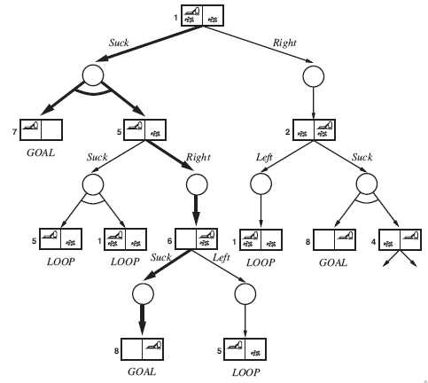
Solution is a subtree that:
has a goal node at every leaf
specifies one action at each OR node
includes every outcome branch at each AND node.

Slide 19
Searching with Partial Observations
When an environment is partially observable, an agent can be in one of several possible states. An action leads to one of several possible outcomes.
To solve these problems, an agent maintains a belief state that represent the agent's current belief about the possible physical state it might be in, given the sequence of actions and percepts up to that point.

Slide 20
Searching with No Observation
When an agent's percepts provide no information at all, this is called a sensorless (or conformant) problem
Example: deterministic, assume know geography, but not location or dirt.
Initially could be in any state { 1, 2, 3, 4, 5, 6, 7, 8 }
Do Right, must in { 2, 4, 6, 8 }.
Do Suck results in { 4, 8 }.
Doing Left, then Suck coerces world into state 7 regardless of initial state

Slide 21
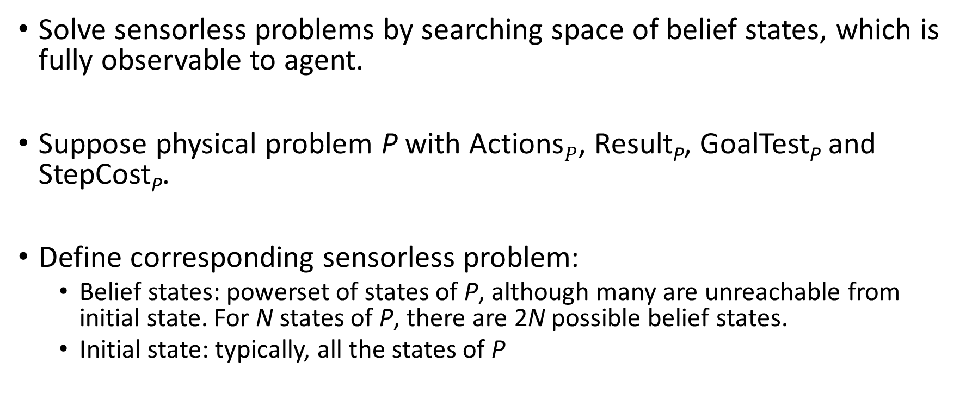
Searching with No Observation
Solve sensorless problems by searching space of belief states, which is fully observable to agent.
Suppose physical problem P with Actions$P$, Result_{P}, GoalTest_{P} and StepCost_{P}.
Define corresponding sensorless problem:
Belief states: powerset of states of P, although many are unreachable from initial state. For N states of P, there are 2N possible belief states.
Initial state: typically, all the states of P

Slide 22
Searching with No Observation
Actions: if illegal actions are safe, use the union of actions of all states in b; otherwise use the intersection. Use to predict the next belief states.
Transition model: b' = Result (b, a) = { s' : s' = Result_{P} (s, a) and s∈b }. Similarly for nondeterministic environments using Results_{P}.
Goal test: all of the physical states in b must satisfy GoalTest_{P}
Path cost: Assume that action costs same in all states, so transfer from underlying problem.

Slide 23
Searching with No Observation
For a general partially observable problem, need to specify how the environment generates percepts for agent. Encapsulated in function Percept (state). Special cases:
Percept (s) = s, for fully observable environments
Percept (s) = null, for sensorless problems
Example: in vacuum cleaner world Percept (1) = [ A, Dirty ]

Slide 24
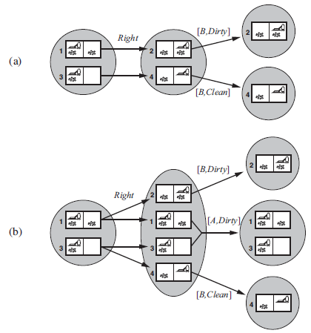
Searching with No Observation
Example: first percept is [ A, Dirty ], do Right
In deterministic environments, percepts reduce size of belief state
In nondeterministic environments, belief state may become larger

Slide 25
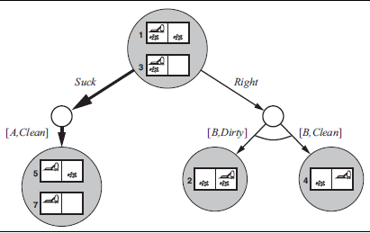
Solving Partially Observable Problems
Use AND-OR search to solve.
Top part of tree starting with [ A, Dirty ].
Solution is conditional plan:
[ Suck, Right, if Bstate = { 6 } then Suck else [ ] ]

